Slide 1
Continuous Monitoring
SE489: DevOps Engineering

Slide 2
Outline
Monitoring in DevOps
Why we need Continuous Monitoring?
What is Continuous Monitoring?
Continuous Monitoring Tools
What is Nagios?
Nagios Case Study

Slide 3
Monitoring in DevOps

Slide 4
What is DevOps Monitoring?
DevOps monitoring entails overseeing the entire development process from planning, development, integration and testing, deployment, and operations.
It involves a complete and real-time view of the status of applications, services, and infrastructure in the production environment.
Features such as real-time streaming, historical replay, and visualizations are critical components of application and service monitoring.

Slide 5
What is DevOps Monitoring?
DevOps monitoring allows teams to respond to any degradation in the customer experience, quickly and automatically.
More importantly, it allows teams to “shift left” to earlier stages in development and minimize broken production changes.
An example is better instrumentation of software to detect and respond to errors, both manually through on-call and also automatically whenever possible.

Slide 6
Monitoring in DevOps
Monitoring provides feedback from production.
Monitoring delivers information about an application's performance and usage patterns.
Is monitoring all about?
Monitoring the live application
How about, monitoring followings
Planning, Development, Integration and Testing, Deployment, and Operations
Continuous Monitoring
a.k.a. ConMon

Slide 7
Monitoring in DevOps
Continuous monitoring in DevOps has a few specific goals, as are mentioned below:
Continuous monitoring aims to strengthen the transparency of such environments while keeping in place a vigilant system to monitor and resolve said issues.
Continuous monitoring aims to identify performance inconsistencies and error sources. It also resolves these problems using relevant solutions to safeguard the enterprise.
Continuous monitoring assists companies in keeping a tab of their user experience. CM is especially helpful in tracking user feedback after a recent change or update to a software or an application. This helps firms build and strengthen their business strategies.

Slide 8
Monitoring Goals
Achieve high availability
Reduce time to detect (TTD)
Reduce time to mitigate (TTM)
Reduce time to remediate (TTR)
Real-time feedback
On the overall health of IT infrastructure
Application performance issues
Visibility and transparency of network activity
Monitor user behavior and feedback
Experience with new updates

Slide 9
Importance of DevOps Monitoring
Visibility
E.g. Team members need to see all events when a failure occur
Automated Collaboration
All team members should get the notification to events (merge request, commits, merge, etc.) automatically
E.g. Git or Gitlab Slack or Webex notification
Push
Issues
Merge Requests
Comments
Pipeline
Deployment
Code quality, Test report, Code coverage, etc…
Mitigate the risk of cyber attacks
With real-time alert system

Slide 10
Importance of DevOps Monitoring
Change management
Quickly see the changes that cause application outage
Monitoring dependencies
You are using latest version of a external tools
There is an update in the third party tools and
Monitor if that third party tool itself is not vulnerable
Monitoring external tools/services

Slide 11
Why we need Continuous Monitoring?

Slide 12
Why we need Continuous Monitoring?
Failure of CI/CD Pipelines
Application Issues
Infrastructure Issues
Static Code Analysis

Slide 13
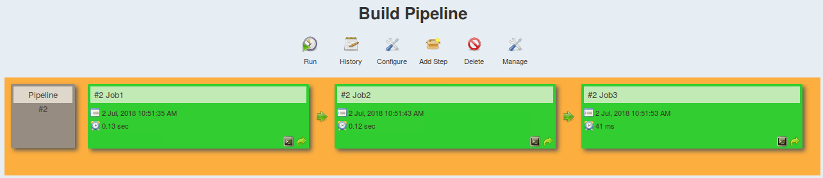
Why we need Continuous Monitoring?
Issues with CI/CD Pipelines:
Rapid introduction of performance problems and errors
Rapid introduction of new endpoints causing monitoring issues
Lengthy root cause analysis as the number of services expands

Slide 14
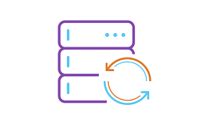

Why we need Continuous Monitoring?
</>
Running APM solutions earlier in lifecycle
Production-like Environment
Feedback of how application will perform in production
Taking corrective actions

Slide 15

Why we need Continuous Monitoring?
Server health cannot be compromised at any cost
Increase response time

Slide 16

Why we need Continuous Monitoring?
Static code analysis will give insights about your code

Slide 17
What is Continuous Monitoring?

Slide 18
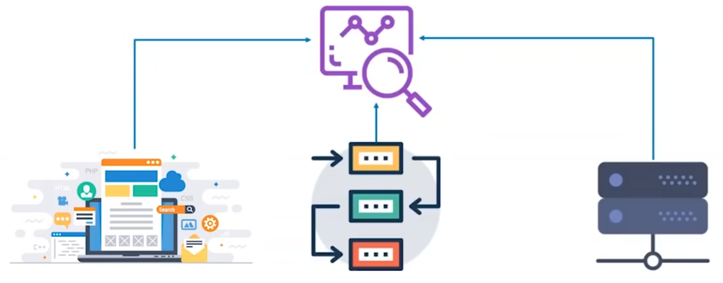
What is Continuous Monitoring?
Effective comprehensive monitoring approach is essential for visibility of your application and Infrastructure

Slide 19
What is Continuous Monitoring?
Continuous Monitoring (CM), is an automated process by which DevOps personnel can observe and detect compliance issues and security threats during each phase of the DevOps pipeline.
Once the software is released into production, Continuous Monitoring will notify dev and QA teams in the event of specific issues arising in the prod environment.
It provides feedback on what is going wrong, which allows the relevant people to work on necessary fixes as soon as possible.
It assists IT organizations, DevOps teams in particular, with procuring real-time data from public and hybrid environments.

Slide 20
What is Continuous Monitoring?
Continuous monitoring is the process of identifying threats to the security and compliance rules of a software development cycle and architecture.
Helps business and technical teams determine and interpret analytics to solve crucial issues
Help enterprises acquire data from various ecosystems
It is a fully automated procedure

Slide 21
Continuous Monitoring Aim
Strengthen the transparency of the ecosystem
Monitor and resolve issues
Identify and resolve performance inconsistencies and error sources
Assist companies in keeping a tab of their user experience

Slide 22
Types of Continuous Monitoring
Infrastructure Monitoring
Nagios and Prometheus
Application Monitoring
Datadog and Splunk
Network Monitoring
Wireshark and NMap

Slide 23
Infrastructure Monitoring
Containers, VMs, Physical machines/servers
Resource utilization
Software
Storage servers
Cluster performance

Slide 24
Application Monitoring
Uptime
Transaction time and volume
System responses, throughputs, error rate
API responses
Front-end and back-end
Page load time
# of HTTP requests, request rate, HTTP request execution time, etc.

Slide 25
Network Monitoring
Network traffic, bandwidth, packet flows
Firewalls, Gateways, VPNs, security groups
Network interfaces, IPs
Endpoints,
Load balancers, latency
SSH, pings, connections, etc…

Slide 26
User behavior
Usually tradition monitoring are not that useful for this category
How users are using your application ?
Overall customer experience
Usage of application
Application specific data
YouTube, CuriosityStream, Vimeo, etc.
Financial applications
Education application
Ecommerce application
Social networking applications

Slide 27
Benefits of Continuous Monitoring
Better security
Automate many security measures.
Performance errors are detected earlier
Help determine performance inconsistencies
System downtime is significantly reduced
Keep a vigilant eye on the database, network, and applications, helping to resolve any issues before they give rise to system downtime
Facilitates better performance for the business
By alleviating system downtimes, it improves user experience and business credibility

Slide 28
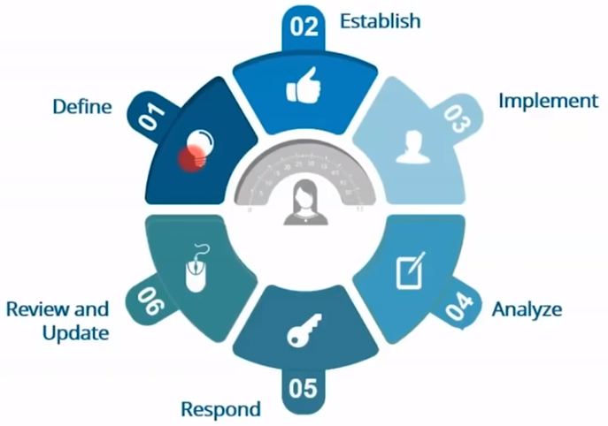
Continuous Monitoring Phases - NIST

Slide 29
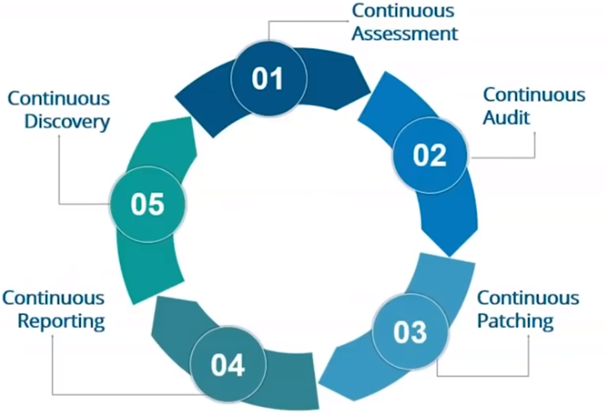
Continuous Monitoring Phases - Patriot

Slide 30
Best Practices for Continuous Monitoring in DevOps
Decide what to monitor: Different organizations need to monitor different aspects of their IT landscape. Primarily, the targets are categorized into the following:
Server status and health
Application performance log
System vulnerabilities
Development milestones
User activity/behavior
As far as possible, try to track parameters belonging to each category.

Slide 31
Continuous Monitoring Tools

Slide 32
Monitoring tool features
Real-time streaming and alert
On critical components of application and services
On hardware, application, operation
Configurable alert
Query health status
Automatic reporting
Automated log aggregation
Data analytics
Historical replay
Visualizations
Use of REST APIs

Slide 33
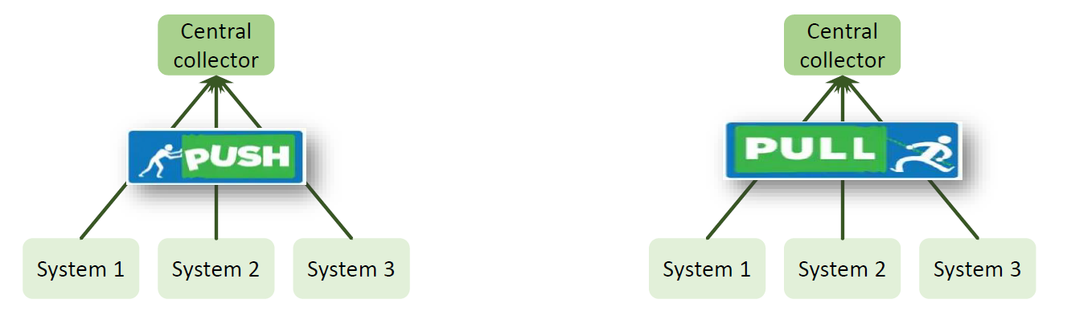
Push vs Pull mechanism
Metrics are periodically sent by each monitored system to a central collector
Central collector periodically
requests metrics from each
monitored system

Slide 34
Push vs Pull mechanism
Features
Discovery:
Push: No need to configure collector, agent just need to be ready to push the metrics
Pull: you need to configure and reload the collector periodically
•Scalability:
Push: Fully distributed
Pull: More centralized
Security
Against remote attack

Slide 35
Push vs Pull mechanism
Features
Latency
Push: what happen when 1000 systems push metrics to single collector?
Pull: single collector need to make 1000 requests to get the updated information
Complexity
Complexity for Agent
What happen when there large number of agents?
Complexity of Collector
Flexibility
Push: pre-determined metrics are pushed
Pull: can get any metric at any time from any monitored system

Slide 36

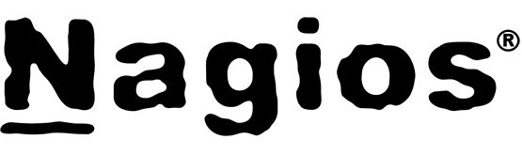
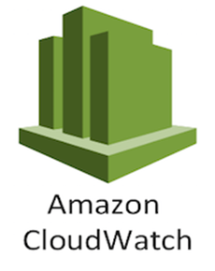



Continuous Monitoring Tools

Slide 37
What is Nagios?

Slide 38
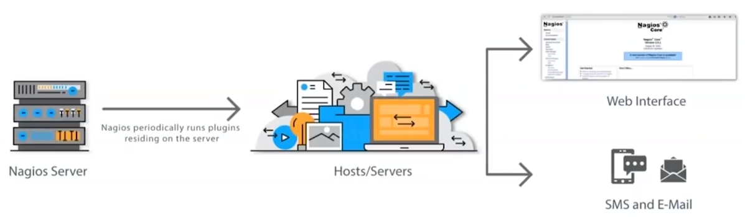
What is Nagios?
Nagios monitors your entire IT infrastructure to ensure systems, applications, services, and business processes are functioning properly.

Slide 39
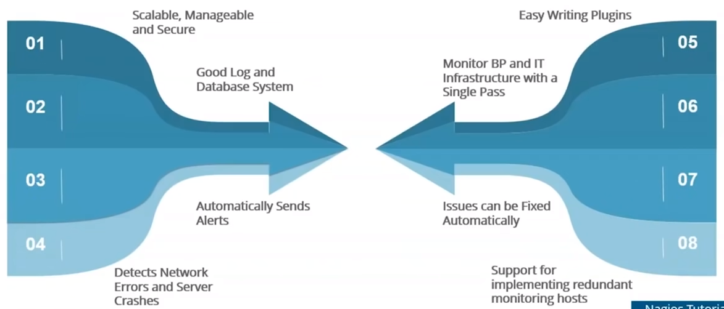
Nagios Features

Slide 40
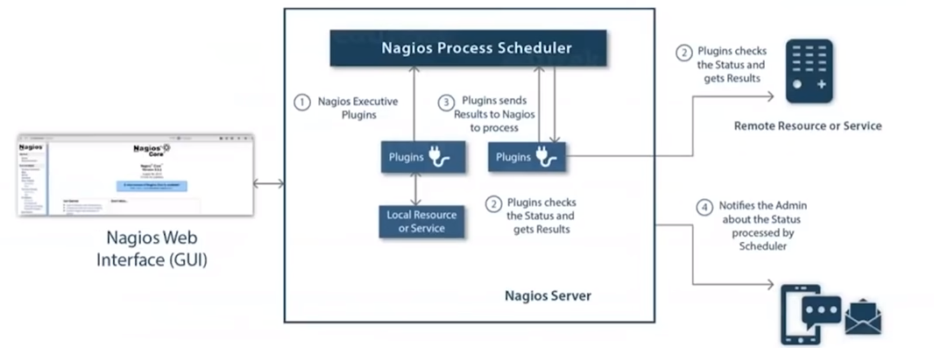
Nagios Architecture
Nagios is built on server/agents architecture
Nagios server is running on a host, and plugins interact with local and remote nodes
Plugins will send information to the Scheduler

Slide 41
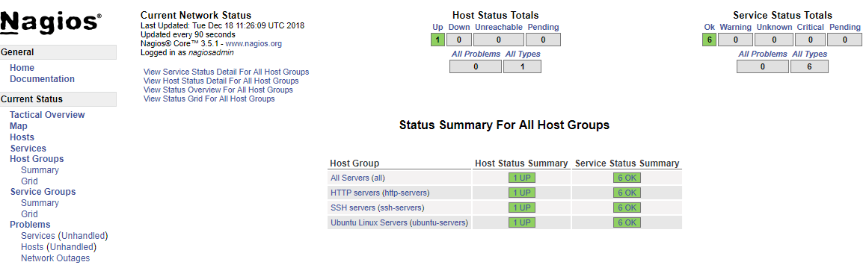
Nagios Dashboard

Slide 42
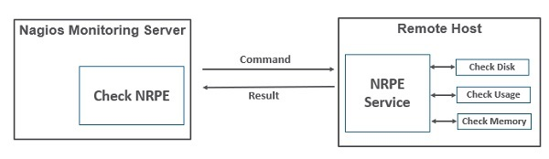
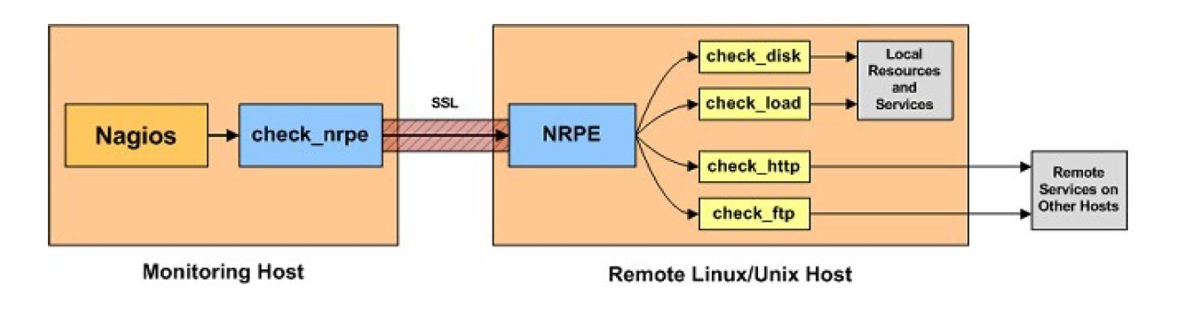
Monitoring Remote Linux Hosts

Slide 43
Nagios Case Study

Slide 44
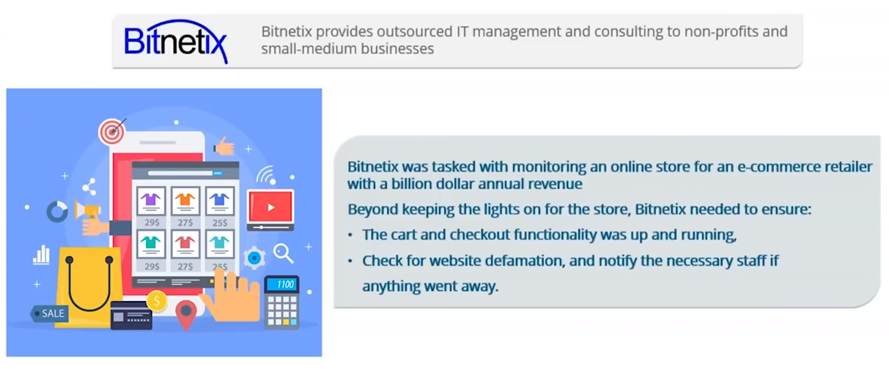
Nagios Case Study - Bitnetix
Bitnetix was tasked with monitoring an online store for an e-commerce retailer with a billion dollar annual revenue.
Beyond keeping the lights on for the store, Bitnetix needed to ensure:
The cart and checkout functionality was up and running
Cehck fro website defamation, and notify yhe necessary staff if anything went away

Slide 45
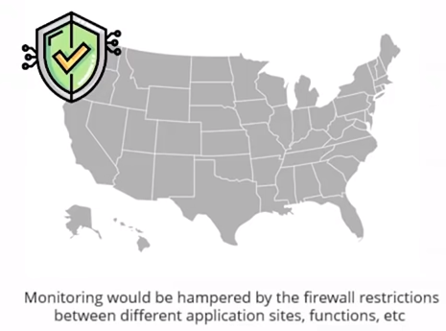

Challenge
Bitnetix hit a roadblock upon realizing that the client's data center was located in Seacacus, New Jersey, more than 500 miles away from their staff in Rochester, NY
Dev
Test
Prod

Slide 46
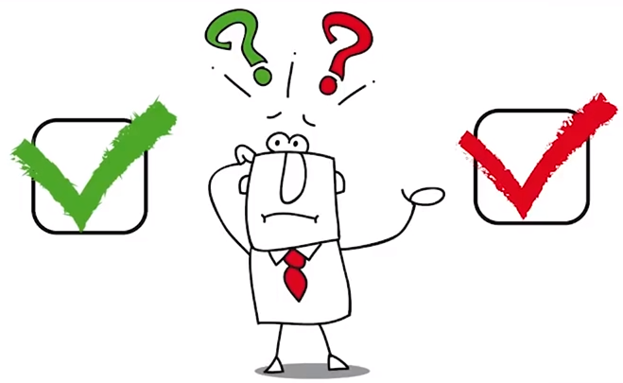
Challenge
Bitnetix hit a roadblock upon realizing that the client's data center was located in Seacacus, New Jersey, more than 500 miles away from their staff in Rochester, NY
Most of the notifications sent to the client were ignored because there were so many false positives

Slide 47
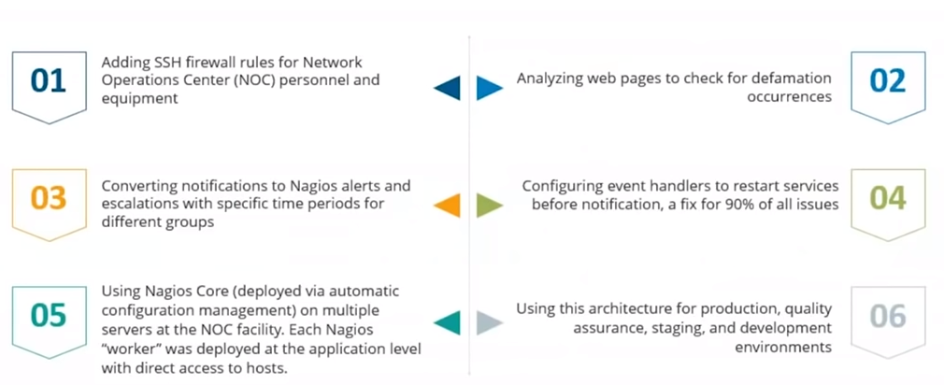
Solution

Slide 48
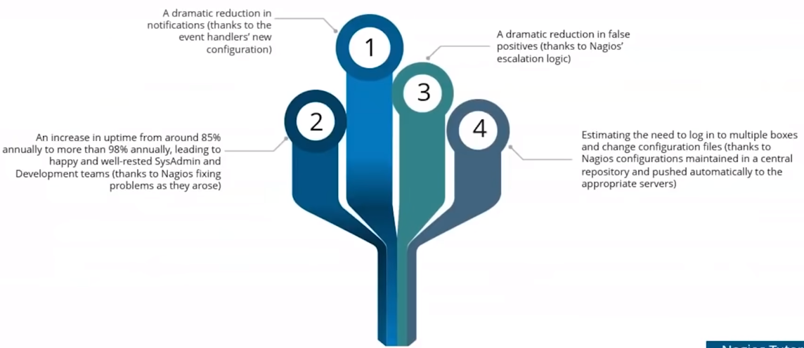
Results

Slide 49

Nagios Case Study - Tier 4 certified data center
Client Details:
The client is India’s first Tier 4 certified data center providing a penalty backed SLA of 99.995% uptime.
Silicon India has acknowledged the client as one of the Top 25 Cloud Computing companies in India based on economy, usability and flexibility.
It is the Cloud Providers in India offers Private Cloud on Demand, Cloud hosting and cloud servers hosting solutions.

Slide 50
Nagios Case Study - Tier 4 certified data center
Problems Faced :
The client wanted a tool which can provide graphical resource utilization with time flexibility on (weekly or monthly basis)
They were in need of top 10 alerts in graphical mode.

Slide 51
Nagios Case Study - Tier 4 certified data center
Solutions Offered:
The client installed Nagios Core already & was looking for an upgrade.
Installed Nagios XI to provide graphical resource utilization updates on weekly or monthly basis with top 10 alerts.

Slide 52
Nagios Case Study - Tier 4 certified data center
Goals Achieved:
They have reached client's expectations by providing graphical resource utilization as per their requirement.
The client is now able to manage network effectively with top 10 alerts.

Slide 53
Nagios Case Study - Tier 4 certified data center
Results Obtained:
Graphical resource utilization.
Weekly or monthly reports.
Top 10 alerts in graphs.
Nagios XI advanced features.
Monitor with updated web UI.
Central view of IT ops n/w

